Slide 1
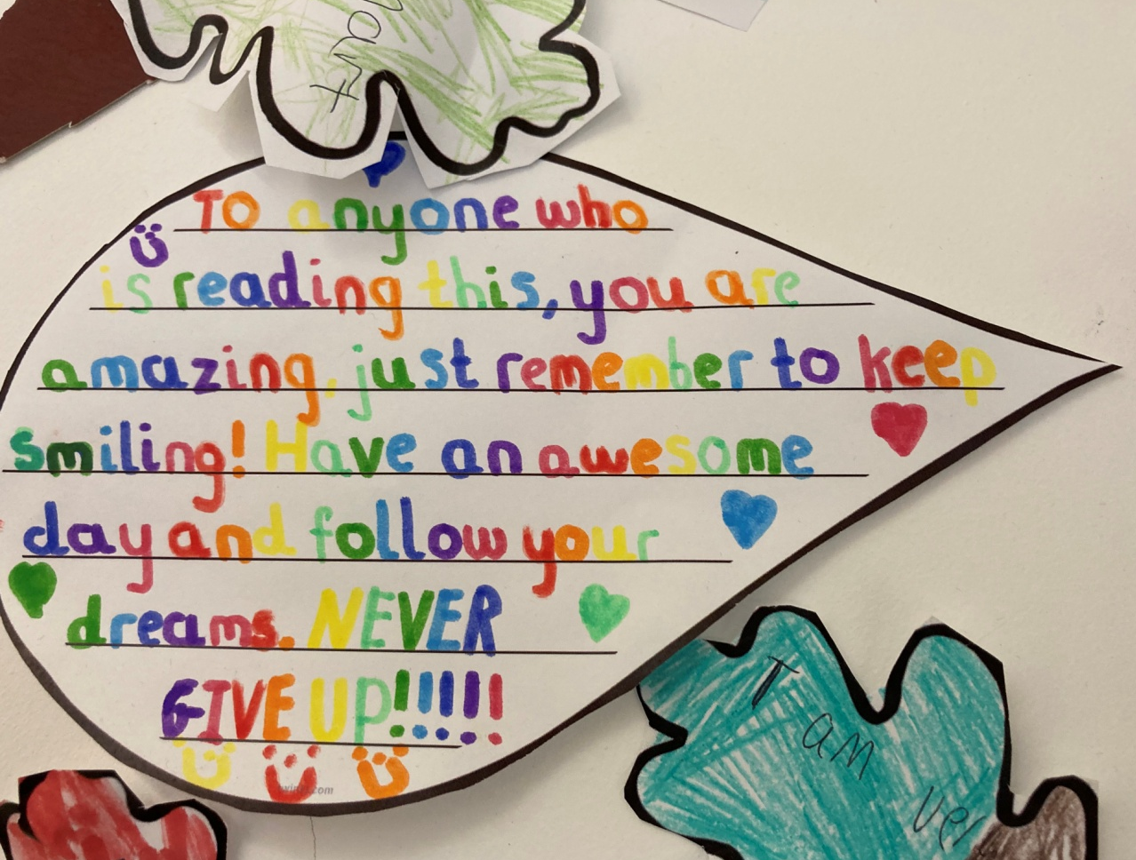
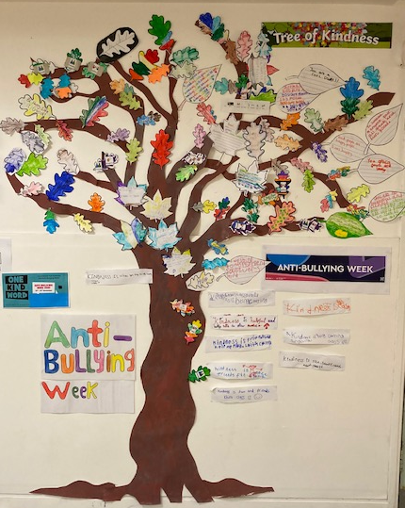

Transition to Post-16
2023-4

Slide 2
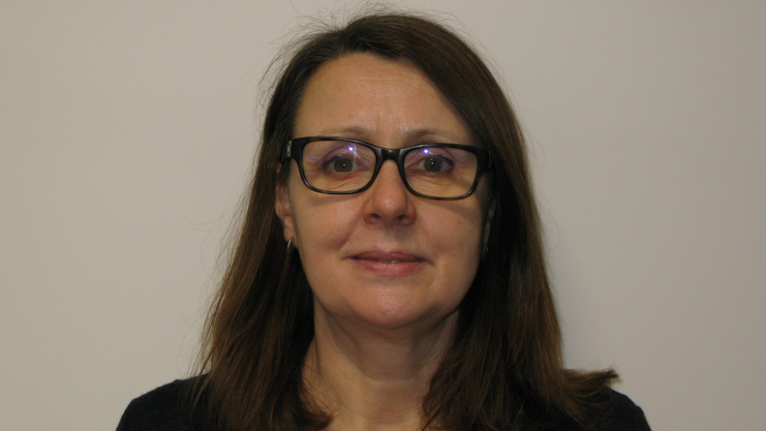

Head of Department
Post-16
Ms Sarah Dann
Photo
sarah.dann@oaklodgeschool.org

Slide 3
Post-16 Provision at Oak Lodge
Oak Lodge offers a 3-year Post-16 provision :
year 12, year 13 and year 14.

Slide 4
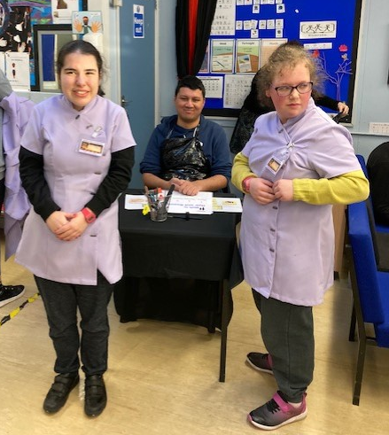
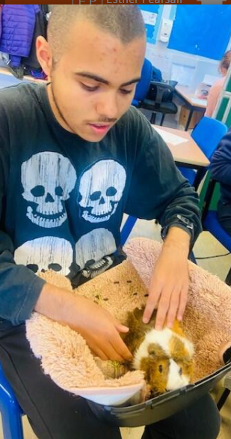
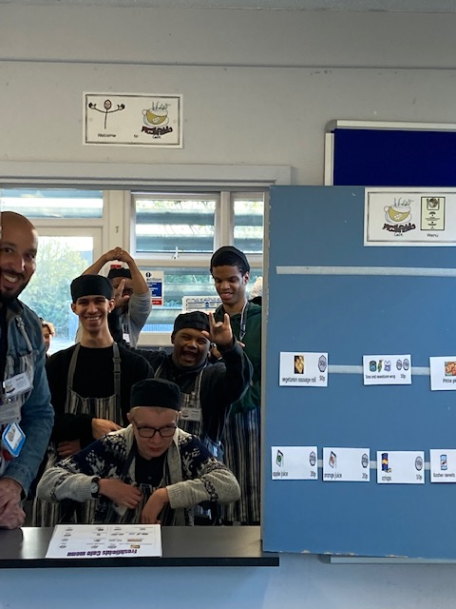
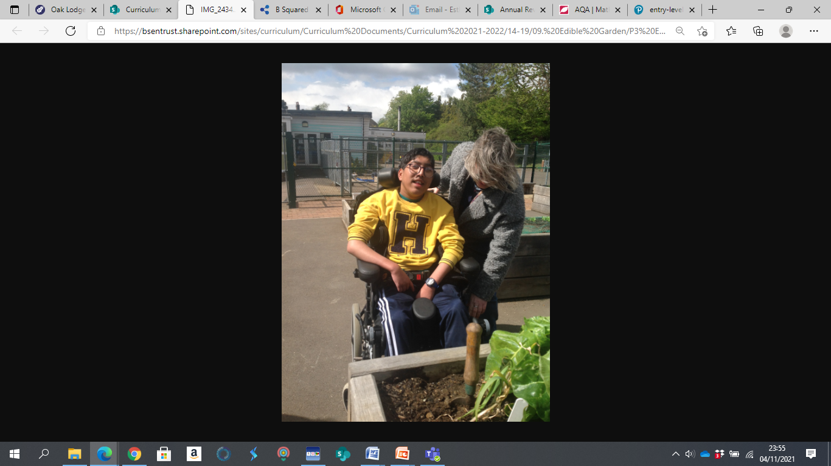
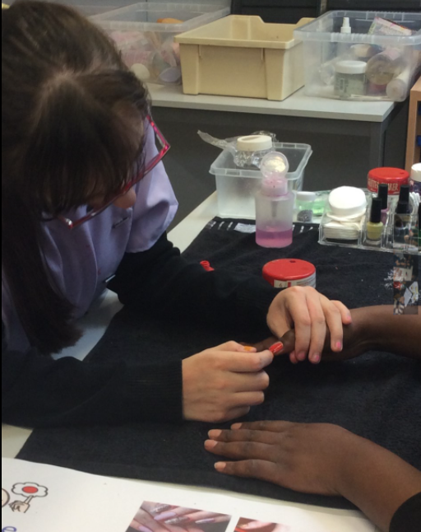
Post-16 Vocational Learning
Wednesday afternoon period 5 and 6
Form teachers and Subject Teachers deliver options
Students will take part in options tasters for 6 weeks , helping them make an informed choice.

Slide 5
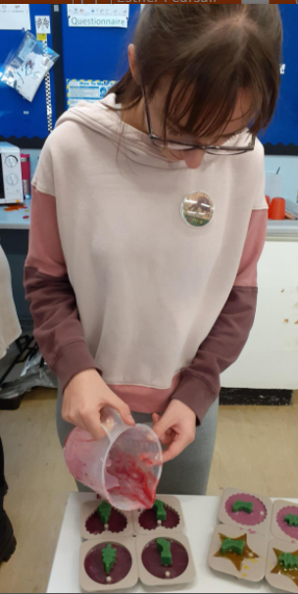
Post-16 Vocational Learning
Skills for Work – Fridays period 1 and 2
Each workshop has a different focus and classes will do a different workshop, with a different Post 16 teacher, each half term.
Skills for Work workshops focus on :
Travel Training
Communication and Interview Skill
Exploring (voluntary) jobs, courses and training
Team Enterprise
Working as a Team – Team-work skills and team building
Problem Solving

Slide 6
Post-16 Personalised Vocational Certification
Internal Certification
All vocational units and courses
WJEC Creative Media and Performance Arts Entry Level 2 and 3 – Unit /Award
Music
Drama
WJEC Entry Level Pathway Preparing for Work Entry Level 2 and 3 – Unit/Award
Gardening
Animal Care
Hair and Beauty
Serving food and drink
Customer service in the hospitality Industry
Basic cooking
OCR Entry Level PE
OCR Entry Level Art

Slide 7
Post -16 PSD, English and Maths
Pre Entry & Entry Level 1
WJEC Entry Level Pathway Personal Progress
Entry Level 2, Entry 3 and Level 1
WJEC Entry Level Pathway Independent Living
Personal and Social Development Curriculum
Pre Entry
WJEC Entry Level Pathway Personal Progress
Entry Level 1-3 & Level 1-2
Pearson Functional Skills
Set English and English for Everyday Life
Entry Level 1-3
OCR English Entry Level
Pre Entry
WJEC Entry Level Pathway Personal Progress
Entry Level 1-3 & Level 1-2
Pearson Functional Skills
Set Maths and Maths for Everyday Life
Entry Level 1-3
AQA English Entry Level

Slide 8
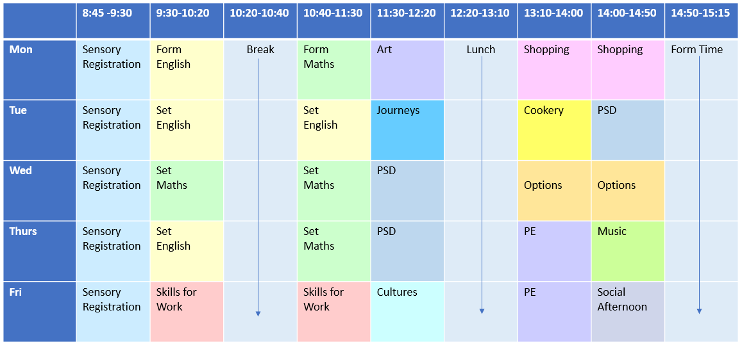
Example Post-16 Timetable
PSD- Personal and Social Development

Slide 9
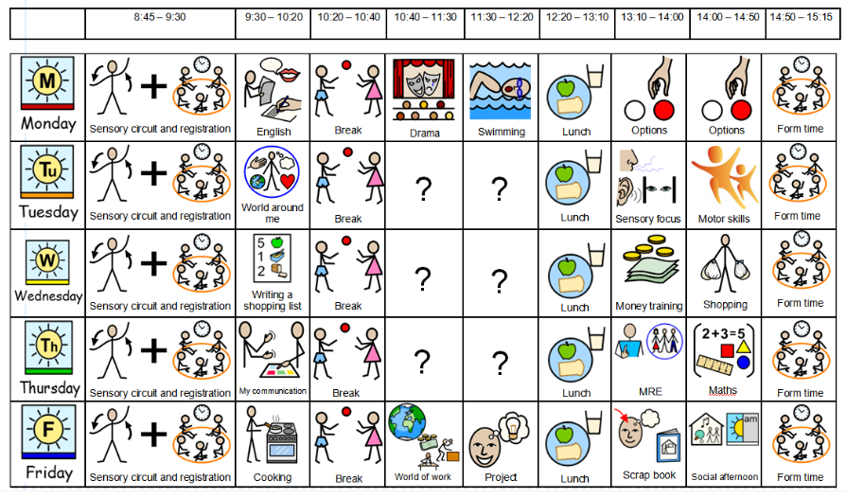
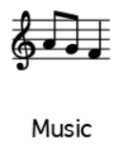







Example Post-16 Sensory Timetable

Slide 10
Post-16 PSD 2023-24
WJEC Entry Level Pathway Personal Progress Pre Entry and Entry Level 1
Autumn ​ | Spring ​ | Summer ​
Developing Independent Living Skills :​ Having your Say ​ ​WJEC PP Unit 6061​ - 3 credits | Developing Independent ​Living Skills :​ Having your Say ​ ​WJEC PP Unit 6061​ | Developing Independent ​ Living Skills :​ Having your Say ​ ​WJEC PP Unit 6061​
Engaging with the world around you: Events ​ ​​WJEC PP Unit 6078​ - 3 credits | Developing Skills for the workplace : following instructions ​ ​WJEC PP Unit 6065​ - 2 credits ​ | Developing Community participation skills : getting out and about ​ ​WJEC PP Unit 6068​ - 5 credits ​ ​
WJEC Entry Level Pathway Independent Living at Entry 2,Entry 3 and Level 1
Autumn ​ | Spring ​ | Summer ​
Choices and Decisions Independent Living Unit 6123- 1 credit ​ | Choices and Decisions Independent Living Unit 6123 | Choices and Decisions Independent Living Unit 6123
Myself within the Community Independent Living Unit 6124 – 2 credits | Myself within the Community Independent Living Unit 6124 | Myself within the Community Independent Living Unit 6124
Managing Social Relationships PSD: Unit 6107 E2 – 1 credit Unit 6118 E3 & L1 ​- 1 credit | Learning about workplaces​ Preparing for work Unit: 6126 - 1 credit | Planning a Journey Independent Living Unit 6125 – 1 credit ​

Slide 11
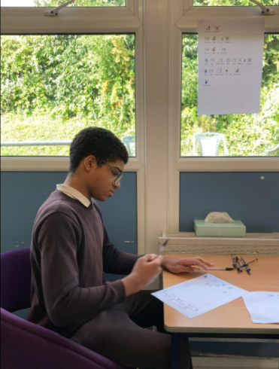
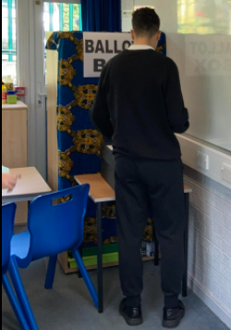
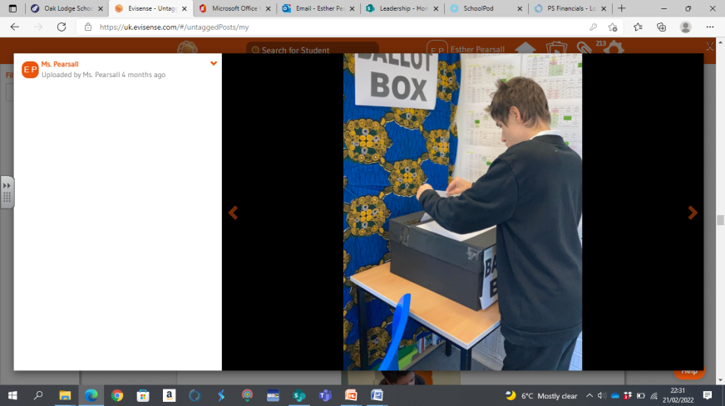
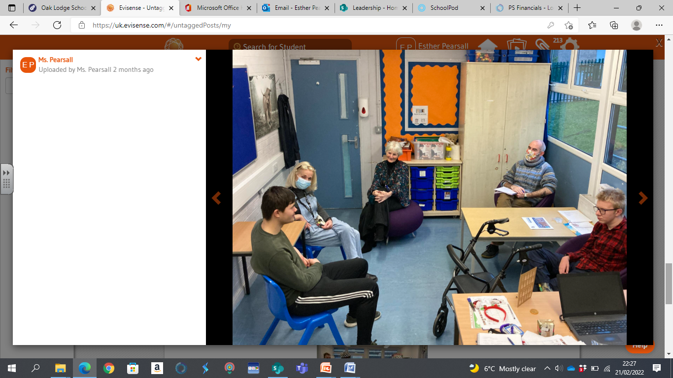
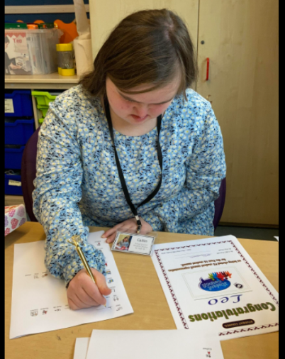
Student Council
Post-16
Student Council
Election Day
Date TBC

Slide 12
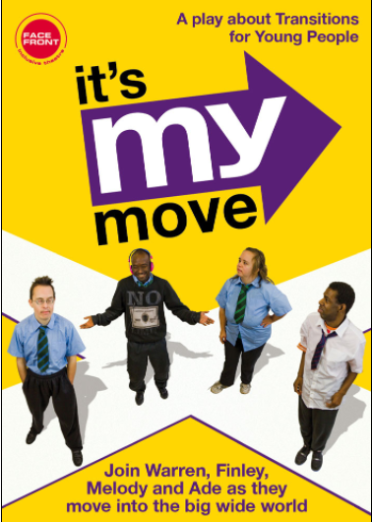
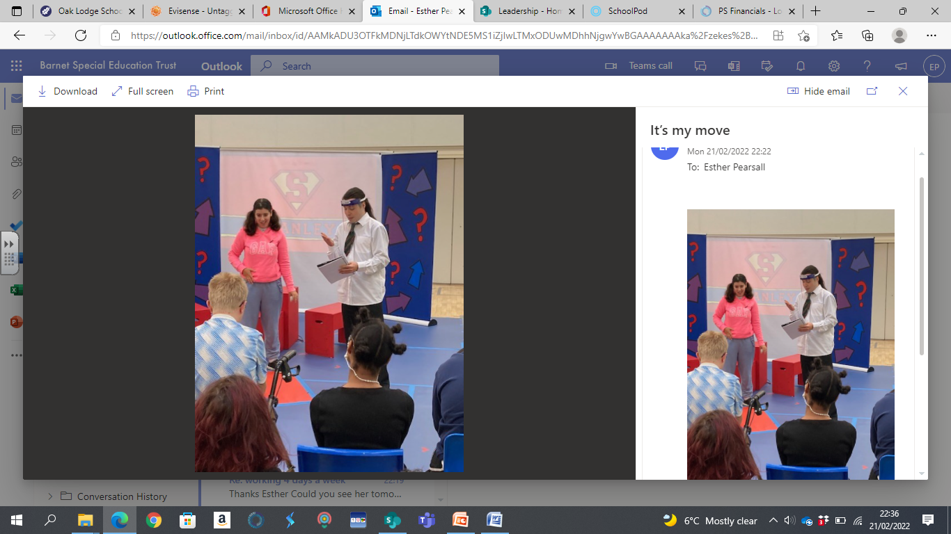
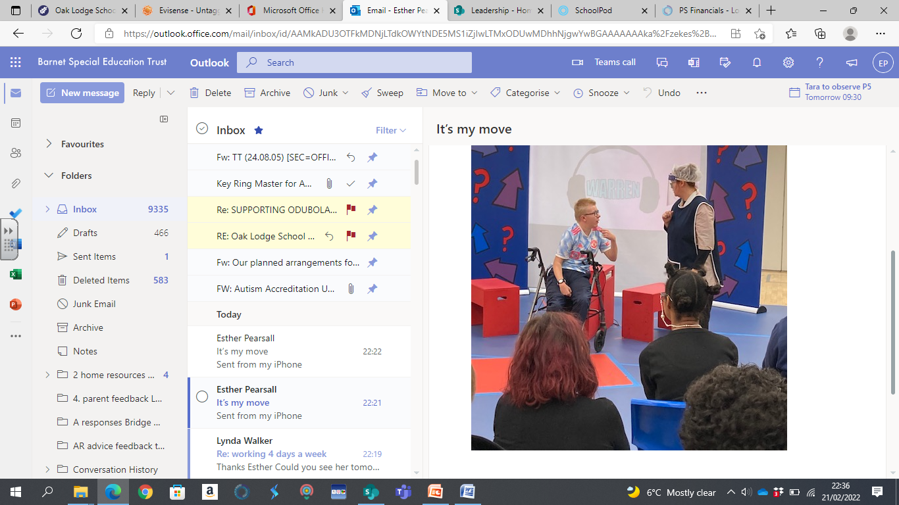

Facefront Theatre
November 2023 (subject to funding)
An interactive play about the transition from school to adult life for young people with mild to moderate Learning difficulties

Slide 13
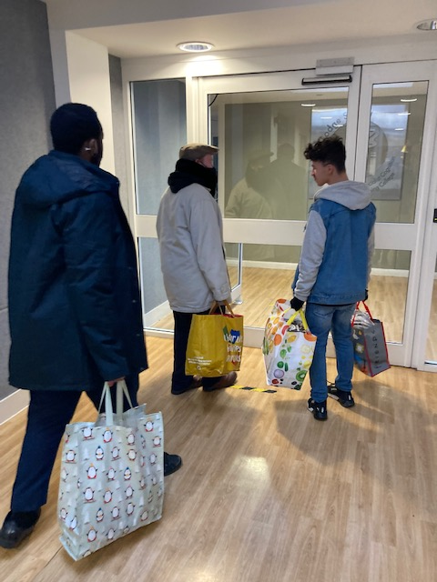
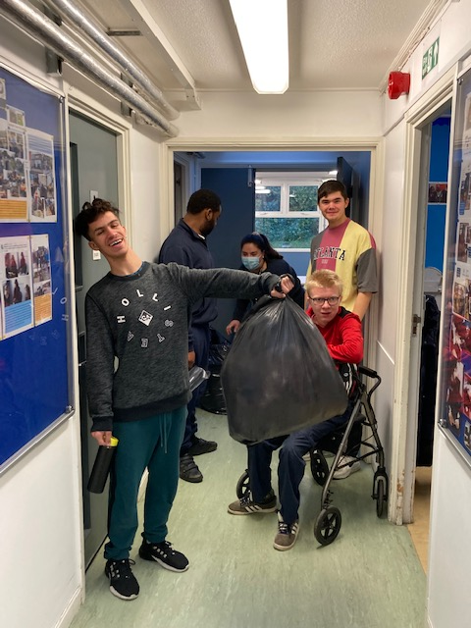
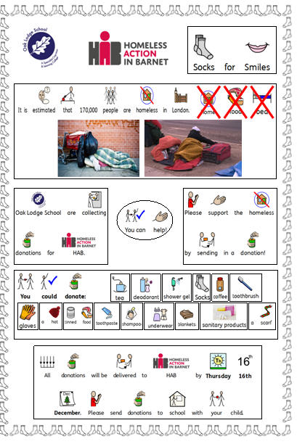
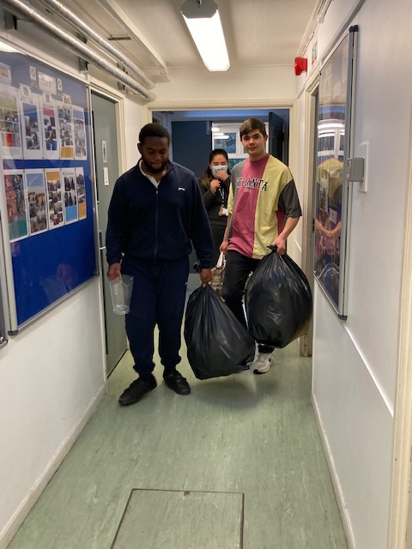
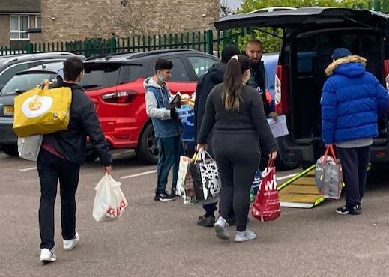
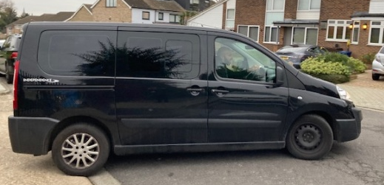
PSD

Slide 14
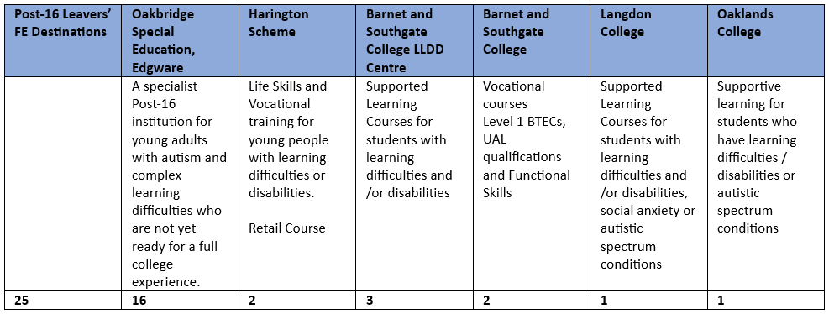
Post-16 Leavers’ Destinations 22-23

